Slide 1
LECTURE 9 Verification, Calibration and Validation
This lecture written by Dr. Fulvio Lopane

Slide 2
CASA0011: Agent-Based Modelling
Dr Sarah WISE
Dr Thomas OLÉRON EVANS
s.wise@ucl.ac.uk
thomas.evans.11@ucl.ac.uk
Moodle password: ABM19
Centre for Advanced
Spatial Analysis,
90 Tottenham Court Road

Slide 3
Course Objectives
You should...
1. understand the principles of
agent-based modelling (ABM).
2. be able to describe the type and range of systems to which ABM can be profitably and appropriately applied.
3. be able to conceptualise and model
urban systems with complex dynamics.
4. show evidence of being able to translate your
understanding into the practical methodology of modelling.

Slide 4
The ABM Course
Week 1: Introduction to ABMs
Week 2: Cellular Automata
Week 3: ABM Methodology
Week 4: Agent Behaviours
Week 5: ABMs as Research Tools
READING WEEK
Week 6: Presenting Results & GIS Integration
Week 7: Modelling Competitive Agents
Week 8: Spatial Modelling & GIS
Week 9: Verification and Validation of ABMs
Week 10: Applications of Agent Based Modelling

Slide 5
Feedback

Slide 6
LECTURE OBJECTIVES
1. Understand the concepts of verification, calibration and validation.
2. Learn methods to verify, calibrate and validate ABMs.
3. Apply those concepts and methods to existing models.

Slide 7
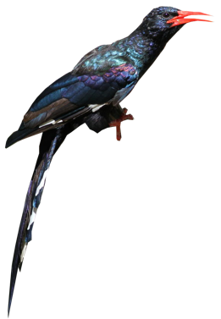
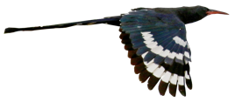

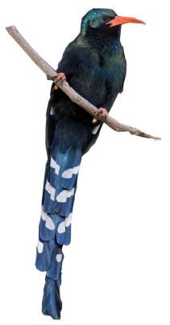
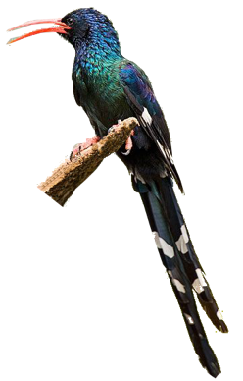



Lecture Outline
1. Evaluating Models
2. Verification
Code Testing
Simplifying Environments
Docking
3. Calibration
Qualitative
Quantitative
4. Woodhoopoes NetLogo model
5. Validation

Slide 8



Evaluation
You should be able to
explain and justify
the design choices you make, relative to external observations, other evidence, or simply good practice.
Model evaluation should be considered at all points
in the ABM development cycle.
Even it won’t be, you should develop your model to withstand external scrutiny.
There are a variety of approaches you can take to ensure that your model is well designed and developed.
These can be broadly divided into verification, calibration, and validation methods.

Slide 9







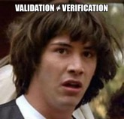
Definitions
Verification is the process of ensuring that model implementation matches model design.
Expectation
Reality
Calibration involves adjusting model parameters to meet observed patterns.
Validation relates to evaluating the performance of the model in relation to previously unobserved data.

Slide 10
Model Development and Analysis
Preparing to Model
Model Implementation
Design
Design & Preparation
Verification
Model Evaluation
Calibration
Explanation
Validation
Prediction

Slide 11
Verification Code Testing

Slide 12
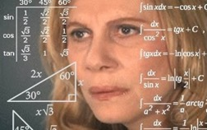
Verification Code Testing
While many IDEs will helpfully point out syntactic errors as your write your code, semantic errors are trickier to spot.
These relate to logical inconsistencies in your code, such as incorrectly used variables, misplaced logic blocks, etc…
Reading code through is a simple solution.
A more formal approach is unit testing, whereby variable values are outputted during the simulation, allowing you to check whether they align with expected values.

Slide 13



Code testing Unit testing
Unit testing is a software testing method by which individual
units of source code
are tested to determine whether they are fit for use.
Sets of one or more computer program
modules and associated control data, usage
procedures and operating procedures.

Slide 14






Code testing Unit testing
Before:
agent_1 = ‘Juventus’
budget_1 = ‘500’
supporters_1 = ‘1.000.000’
agent_2 = ‘Real Madrid’
Budget_2 = ‘500’
supporters_2 = ‘1.000.000’
EXAMPLE: CR7 transfer from RM to JUV in 2018
Interaction between agents: transfer
Transfer cost: ‘100’
Supporters of new team: +30%
Supporters of old team: -20%
After:
agent_1 = ‘Juventus’
budget_1 = ‘400’
supporters_1 = ‘1.300.000’
agent_2 = ‘Real Madrid’
Budget_2 = ‘600’
supporters_2 = ‘800.000’

Slide 15
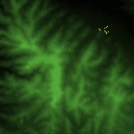



Simplified environments Limiting spatial complexity
While your model will no doubt eventually be based within a real-world spatial environment, testing within other environments allows you to verify that agent behaviour is as you expect.
A simplified environment, separate out agent behaviour from the environment, so you can see if agents are adapting appropriately.
Butterflies hilltopping model: observation of corridors
Credits: Prof. Ed Manley, School of Geography, University of Leeds

Slide 16
Docking Doubling up
Docking involves comparing the behaviour of your ABM against a different but related model.
This could involve implementing your model within a different simulation environment (e.g. NetLogo vs Python), or comparing your model against another modelling methodology.
Similar patterns of behaviour provide verification of your approach, but some differences (where within anticipated bounds) can be expected.
Credits: Prof. Ed Manley, School of Geography, University of Leeds

Slide 17


Docking Example
NetLogo model library: Wolf Sheep Predation (Docked Hybrid)
This model explores the relationship between two different models of predator-prey ecosystems:
an agent-based model
and a aggregate model.
Each of the models can be run separately, or docked side-by-side for comparison.
Full model description: https://ccl.northwestern.edu/netlogo/models/WolfSheepPredation(DockedHybrid)

Slide 18
Systems Dynamics Models
Stocks
Flows
x
α
Notes:
18
18

Slide 19


Lotka-Volterra Model
Prey (x)
Predator (y)
Notes:
19
19

Slide 20

Lotka-Volterra Model
X
DEATH
Y
DEATH
Notes:
20
20

Slide 21
Lotka-Volterra Model
X
DEATH
Y
DEATH
Notes:
21
21

Slide 22
Lotka-Volterra Model
X
DEATH
Y
DEATH
Notes:
22
22

Slide 23
Lotka-Volterra Model
a₁
X
DEATH
c₁₂Y
c₂₁X
Y
DEATH
a₂
Notes:
23
23

Slide 24
Lotka-Volterra Model
Prey (x)
Predator (y)
x = –a₁x – c₁₂xy
y = –a₂y + c₂₁xy
Notes:
24
24

Slide 25
Docking Example
ABM:
Wolves and sheep wander randomly around the landscape
Wolves look for sheep to prey on
Each step costs the wolves energy, and they must eat sheep in order to replenish their energy (energy = 0 → die).
Each wolf or sheep has a fixed probability of reproducing at each time step.
Aggregate model:
A System Dynamics model of the relationship between populations of wolves and sheep. It is based on a version of the famous Lotka-Volterra model of interactions between two species in an ecosystem.
Full model description: https://ccl.northwestern.edu/netlogo/models/WolfSheepPredation(DockedHybrid)

Slide 26
Calibration

Slide 27

Qualitative Calibration
Qualitative calibration involves simple ‘sense checking’
and making broad adjustments based on what you find.
By observing the behaviour of your agents and the model outputs, you should be able to tell if your model matches your expectations and define sensible parameter ranges on which to calibrate your model later.
This does require that you do have some knowledge and
expectation of the behaviours you’re expecting to observe.
Don’t try this if you don’t know what you’re looking for!

Slide 28
Quantitative Calibration Fitting parameters
Once you have a model that you’re mostly happy with, quantitative calibration
methods more accurately compare your model against observed behaviour.
Observed data should be representative of the population you want to simulate, ideally from a similar location or context.
You do not need to test every parameter, but make
careful note of the assumptions you do make.
A basic quantitative calibration should always incorporate
a parameter space search and analysis of model sensitivity.
Credits: Prof. Ed Manley, School of Geography, University of Leeds

Slide 29
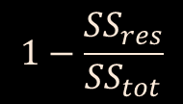
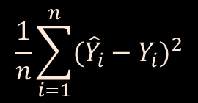
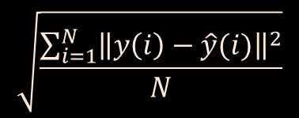
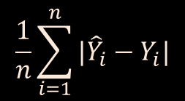
Quantitative Calibration Objective measures
Objective measures could consist in any meaningful indicator, but the below error functions show how we measure between observed and modelled data:
$$\frac{1}{n}\sum_{i=1}^{n}{|{\hat{Y}}_{i}−Y_{i}|}$$
Mean Absolute Error (MAE)
Indicates variance
Mean Squared Error (MSE)
$$\frac{1}{n}\sum_{i=1}^{n}{{({\hat{Y}}_{i}−Y_{i})}^{2}}$$
Amplifies error, indicates variance plus bias
Root Mean Squared Error (RMSE)
$$\sqrt{\frac{\sum_{i=1}^{N}{{\left\|y\left(i\right)−\hat{y}(i)\right\|}^{2}}}{N}}$$
Amplifies error, indicates variance plus bias
in original units
Median Absolute Deviation (MAD)
Median value of absolute deviations
Indicates variance but resilient to dispersion
Coefficient of Determination (R2)
$$1−\frac{{SS}_{res}}{{SS}_{tot}}$$
Residuals of model over variance in data
Credits: Prof. Ed Manley, School of Geography, University of Leeds

Slide 30


Parameter Sweep Search Make it Fit
This process consists of exploring how the
values of each parameter affect model output.
Parameters are tested across a wide range of settings, with each varied one at a time, with model output reported for each configuration.
The best performing settings (e.g. those closest to observed behaviour) for each parameter are reported and can be taken forward.

Slide 31
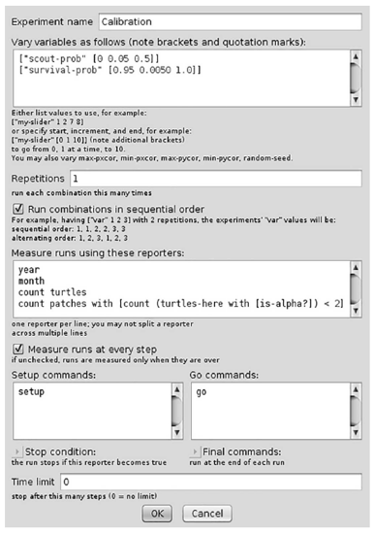
Parameter Sweep Search Using BehaviorSpace
Set a meaningful experiment name
We already know how to do this!
Set the variables and their ranges you’d like to test
Define how many replicates of each combination you will test
Set the measure you will use to report model performance
Tell BehaviorSpace the commands used to setup and run the model
Railsback & Grimm (2019)
Figure 20.2
BehaviorSpace experiment for calibration of the Woodhoopoe model.
Give a cut off for when the model should finish by

Slide 32

Sensitivity Analysis
Sensitivity analysis is the study of how the
parameters of your model affect the final results.
If a small change in the value of a single variable implies big differences in terms of results, then that variable is a governing parameter of your model.
Instead, if big changes in the value of another variable imply small differences in the results, it means that that system is less sensitive with respect to that parameter.
It is important to know which are the governing parameters of
our models, and to understand that, we perform sensitivity analyses.

Slide 33
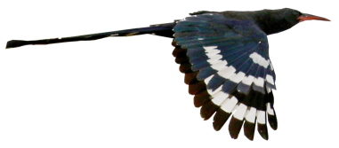

Sensitivity Analysis Woodhoopoes Model

Slide 34
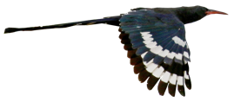
Sensitivity Analysis Woodhoopoes Model
References:
Book chapter:
Steven F. Railsback and Volker Grimm, Agent-Based and Individual-Based Modeling. A Practical Introduction, Second Edition, Princeton: Princeton University Press, 2019 (Second edition), 340 pages, ISBN 978-069119083-9
Model description – Chapter 19.4
Calibration of the model – Chapter 20.5
Original study:
Radford, Andrew N., and Morné A. Du Plessis. “Green Woodhoopoe Phoeniculus Purpureus Territories Remain Stable despite Group-Size Fluctuations.” Journal of Avian Biology, vol. 35, no. 3, 2004, pp. 262–268.
ABM model:
Neuert, C., du Plessis, M. A., Grimm, V., and Wissel, C. (1995). Welche öokologischen Faktoren bestimmen die Gruppengrösse by Phoeniculus purpureus (Gemeiner Baumhopf) in Südafrika? Ein individuenbasiertes Modell. Verhandlungen der Gesellschaft für Ökologie, 24, 145–149.

Slide 35
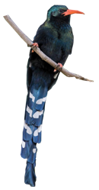
Sensitivity Analysis Woodhoopoes Model
Long-term field study that observed reproductive and mortality rates, group sizes and behaviours of woodhoopoes.
Observed birds’ behaviour:
Each group occupies its own spatial territory.
Each group has a strict hierarchy for both males and females.
Only the alpha couple reproduces.
Subordinates are ranked by age: if an alpha animal dies, it is replaced by the oldest subordinate.
Adult subordinates (>1 year old) undertake scouting forays: they leave their territory and explore the surrounding areas.
When they scout, their chance to be killed by predators is higher than their home territory.
Of the explored territories, the scouting bird occupies the closest to its starting territory that has no alpha of their sex (if no such territory exists, it just returns home).
Source: Railsback & Grimm (2019)

Slide 36
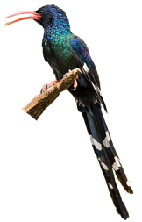
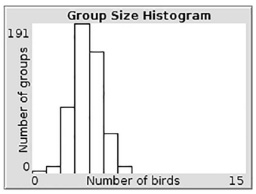
Sensitivity Analysis Woodhoopoes Model
The ABM model:
Key behaviour for which we need theory: decision by subordinates of when to make scouting forays.
ABM = virtual laboratory to test theories.
Two patterns that a theory for scouting forays should cause the ABM to produce:
1. Characteristic group size distribution.
2. The mean age of adult birds undertaking scouting forays is lower than the mean age of all subordinates (averaged over the entire simulation).
Figure 19.2 -Railsback & Grimm (2019)
Source: Railsback & Grimm (2019)

Slide 37

Sensitivity Analysis Woodhoopoes Model
Design concepts:
Basic principles
This model explores the “stay-or-leave” question:
When should a subordinate individual leave a group that provides safety and group success but restricts opportunities for individual success?
In ecology, we can assume real individuals have behaviours for this decision that evolved because they provide “fitness”: success at reproducing.
?
?
?
Emergence
A successful theory will cause the model to reproduce these patterns.
All the patterns emerge from the sub-model for scouting. The group size distribution pattern may also depend strongly on other model processes, such as the reproduction and survival rates.
Source: Railsback & Grimm (2019)

Slide 38
Sensitivity Analysis Woodhoopoes Model
Adaptation
The only adaptive decision the woodhoopoes make is whether to undertake a scouting foray.
Objectives
The subordinate birds have a clear objective: to become an alpha so they can reproduce. We also know, in this model, what processes affect the likelihood of reaching that objective. If the individual stays at its home territory, all the older birds of its sex must die for the individual to succeed to alpha. If the individual scouts, it must find a vacant alpha position and survive the predation risk of scouting to succeed.
Sensing
We assume that birds know nothing about other territories and can sense whether an alpha position is open in another territory only by scouting there.
Source: Railsback & Grimm (2019)

Slide 39


Sensitivity Analysis Woodhoopoes Model
Let’s take a look at the NetLogo model

Slide 40
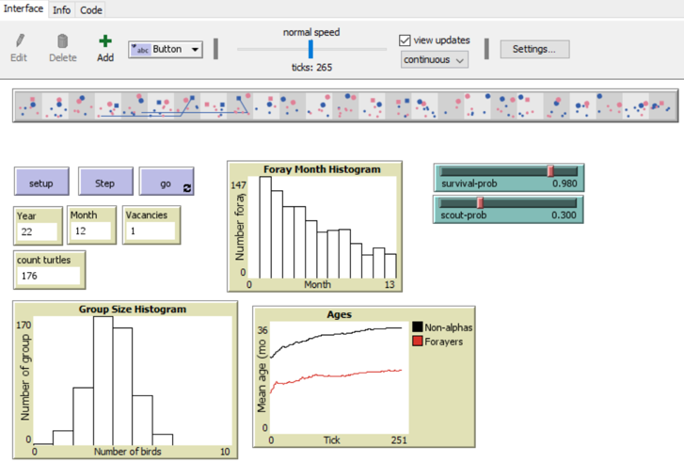
Sensitivity Analysis Woodhoopoes Model
You can find this model here:
http://www.railsback-grimm-abm-book.com/downloads-errata-2nd-edition/

Slide 41


Sensitivity Analysis Woodhoopoes Model
Calibration criteria:
1. Mean abundance: the long-term mean number of woohoopoes is in the range of 115 to 135.
2. Variation: the standard deviation among years in the annual number of birds is in the range of 10 to 15 birds.
3. Vacancy: the average percentage of territories that lack one or both alphas is in the range of 15% to 30%.
Source: Railsback & Grimm (2019)

Slide 42
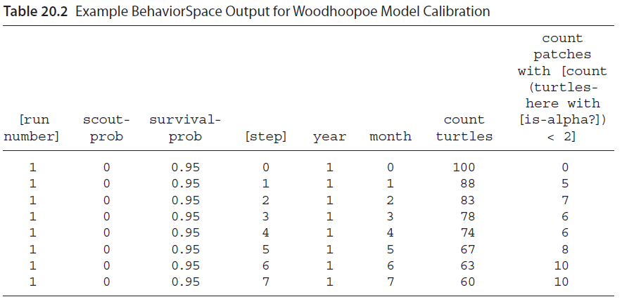
Sensitivity Analysis Woodhoopoes Model
Source: Railsback & Grimm (2019)

Slide 43
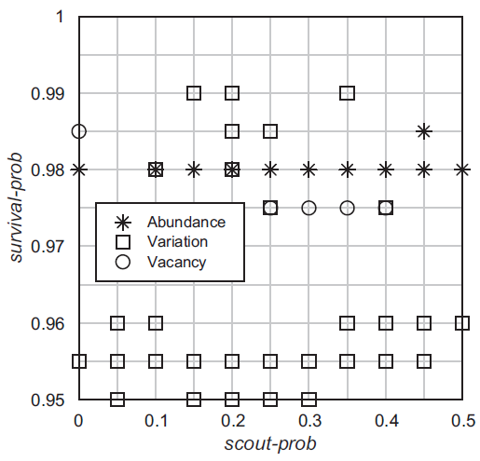
Sensitivity Analysis Woodhoopoes Model
This plot shows which of the 3 calibration criteria are met for each point we simulated in the parameter space.
Figure 20.3
Calibration results for the Woodhoopoe model example. The plot represents the parameter space: the BehaviorSpace experiment ran the model once for each intersection in the grid. The symbols appear at grid locations where the parameter combination caused the model to meet one of the calibration criteria.
Source: Railsback & Grimm (2019)

Slide 44
Sensitivity Analysis Woodhoopoes Model
The abundance criterion depends almost entirely on survival-prob.
It is met almost always and almost only when survival-prob is 0.98
Source: Railsback & Grimm (2019)

Slide 45
Sensitivity Analysis Woodhoopoes Model
The vacancy criterion is only met when survival-prob is 0.975 and scout-prob is in the range (0.25 and 0.4)
Source: Railsback & Grimm (2019)

Slide 46
Sensitivity Analysis Woodhoopoes Model
The variation criterion is met consistently when survival-prob is 0.96 or less, but also with parameters combination near where the abundance and the vacancy criteria are met.
Source: Railsback & Grimm (2019)

Slide 47
Sensitivity Analysis Woodhoopoes Model
Now the results do not look so bad:
in the region
around scout-prob = 0.25–0.4 and survival-prob = 0.975–0.98, there are locations close to
where all three criteria were met.
You could do a second BehaviorSpace experiment focused on this area to see if there are any combinations where all three criteria are indeed met. This example illustrates how calibration is often not successful immediately.
Source: Railsback & Grimm (2019)

Slide 48
Validation
Validation provides a final check of the model performance against unseen observation data.
Calibration has a risk of overfitting a model against observed behaviour, so validation provides a second assurance that this isn’t happening.
The dataset should differ from that used for calibration.
Splitting observation data between calibration and validation is good (80:20 split is usual), but completely different datasets, measuring the same phenomenon, is better.
Credits: Prof. Ed Manley, School of Geography, University of Leeds

Slide 49
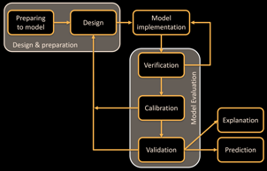

Summary
Evaluation remains one of the key challenges within agent-based modelling, but is increasingly well supported by established methods for verification, calibration, and validation.
Verifying your code is important throughout the ABM development lifecycle, and your work should be compared against simplified or existing models.
Tools such as BehaviorSpace enable quick testing of parameter ranges, and ensure the model is performing as well as it can do relative to observed behaviour.
Sensitivity tests allow us to identify which parameters are dominating the behaviour of your agents, duly or unduly.
Credits: Prof. Ed Manley, School of Geography, University of Leeds

Slide 50
Further Reading
For an excellent chapter summary on ‘Verification, Validation, and Replication’, see :
Wilensky, U. and Rand, W. (2015), An Introduction to Agent-based Modeling: Modeling Natural, Social, and Engineered Complex Systems with NetLogo, MIT Press, Cambridge, MA.
Railsback and Grimm (2011) contains a detailed discussion of Pattern Oriented Modelling and a valuable chapter on ‘Parametrisation and Calibration’ of models.
Railsback, S.F. and Grimm, V. (2011), Agent-Based and Individual-Based Modeling: A Practical Introduction, Princeton University Press, Princeton, NJ.
For a wider theoretical discussions of agent-based modelling, motivation, and validation, see:
Axtell, R. and Epstein, J.M. (1994), ’Agent-based Modelling: Understanding Our Creations’, The Bulletin of the Santa Fe Institute: Winter, 28-32.
Axtell, R. (2000), Why Agents? On the Varied Motivations for Agent Computing in the Social Sciences, Center on Social and Economic Dynamics (The Brookings Institute): Working Paper 17, Washington DC.
Not covered here is a discussion of ‘Empirical Validation’ methods, which is a dominant approach in economic agent-based modelling. For coverage of this area, readers are directed to:
Windrum, P., Fagiolo, G. and Moneta, A. (2007), ’Empirical Validation of Agent-based Models: Alternatives and Prospects’, Journal of Artificial Societies and Social Simulation, 10(2): 8, Available at http://jasss.soc.surrey.ac.uk/10/2/8.html.
While for a comparative analysis of ‘empirical’ and ‘companion’ validation approaches, readers are referred to:
Moss, S. (2008), ’Alternative Approaches to the Empirical Validation of Agent-based Models’, Journal of Artificial Societies and Social Simulation, 11(1): 5, Available at http://jasss.soc.surrey.ac. uk/11/1/5.html.

